Slide 1
CogniSieve Core
2026
FEB
GiveInternshipPlease
Validate Before You Escalate

Slide 2
Table of contents
01
03
02
04
2026
FEB
GiveInternshipPlease
The Challenge
Proposed Solution
Alert fatigue, fragmented visibility and rule based limitations
An AI validation layer enhancing SIEM with behavioral intelligence.
How It Works
Business Impact
Anomaly detection, correlation, scoring, and automated playbooks.
Higher fidelity alerts. Faster response. Reduced noise.

Slide 3
Introduction
2026
FEB
GiveInternshipPlease
Modern banking security teams face overwhelming volumes of rule-based alerts, leading to noise and delayed response. CogniSieve Core adds an AI validation layer that ranks alert fidelity and generates structured response playbooks, fully offline and SIEM-agnostic.

Slide 4
01
Problem Statement & Relevance
2026
FEB
GiveInternshipPlease
High alert volume, low signal clarity, and delayed incident response.

Slide 5

The Challenge
2026
FEB
GiveInternshipPlease
Modern banking SOCs face overwhelming volumes of alerts, making it difficult to distinguish real threats from noise.
High false-positive rates
Limited cross-system visibility
Manual correlation across tools
Analyst fatigue and burnout
Delayed detection of novel threats
The result: slower response times and increased operational risk.

Slide 6
Why It Matters
2026
FEB
GiveInternshipPlease
Fatigue
Novel Threats
Alert Fatigue reduces detection accuracy
Novel threats evade static rule engines
High Risk
Low Automation
High MTTR impacts financial risk exposure
Cross system correlation remains manual

Slide 7
Proposed Solution
2026
FEB
GiveInternshipPlease

Slide 8
Our Solution
2026
FEB
GiveInternshipPlease
Ingest
Securely collects and normalizes logs from ELK and security sources.
Analyze
Escalate
Applies anomaly detection and behavioral correlation to rank alert fidelity.
Generates response playbooks and updates SIEM with high-confidence alerts.

Slide 9
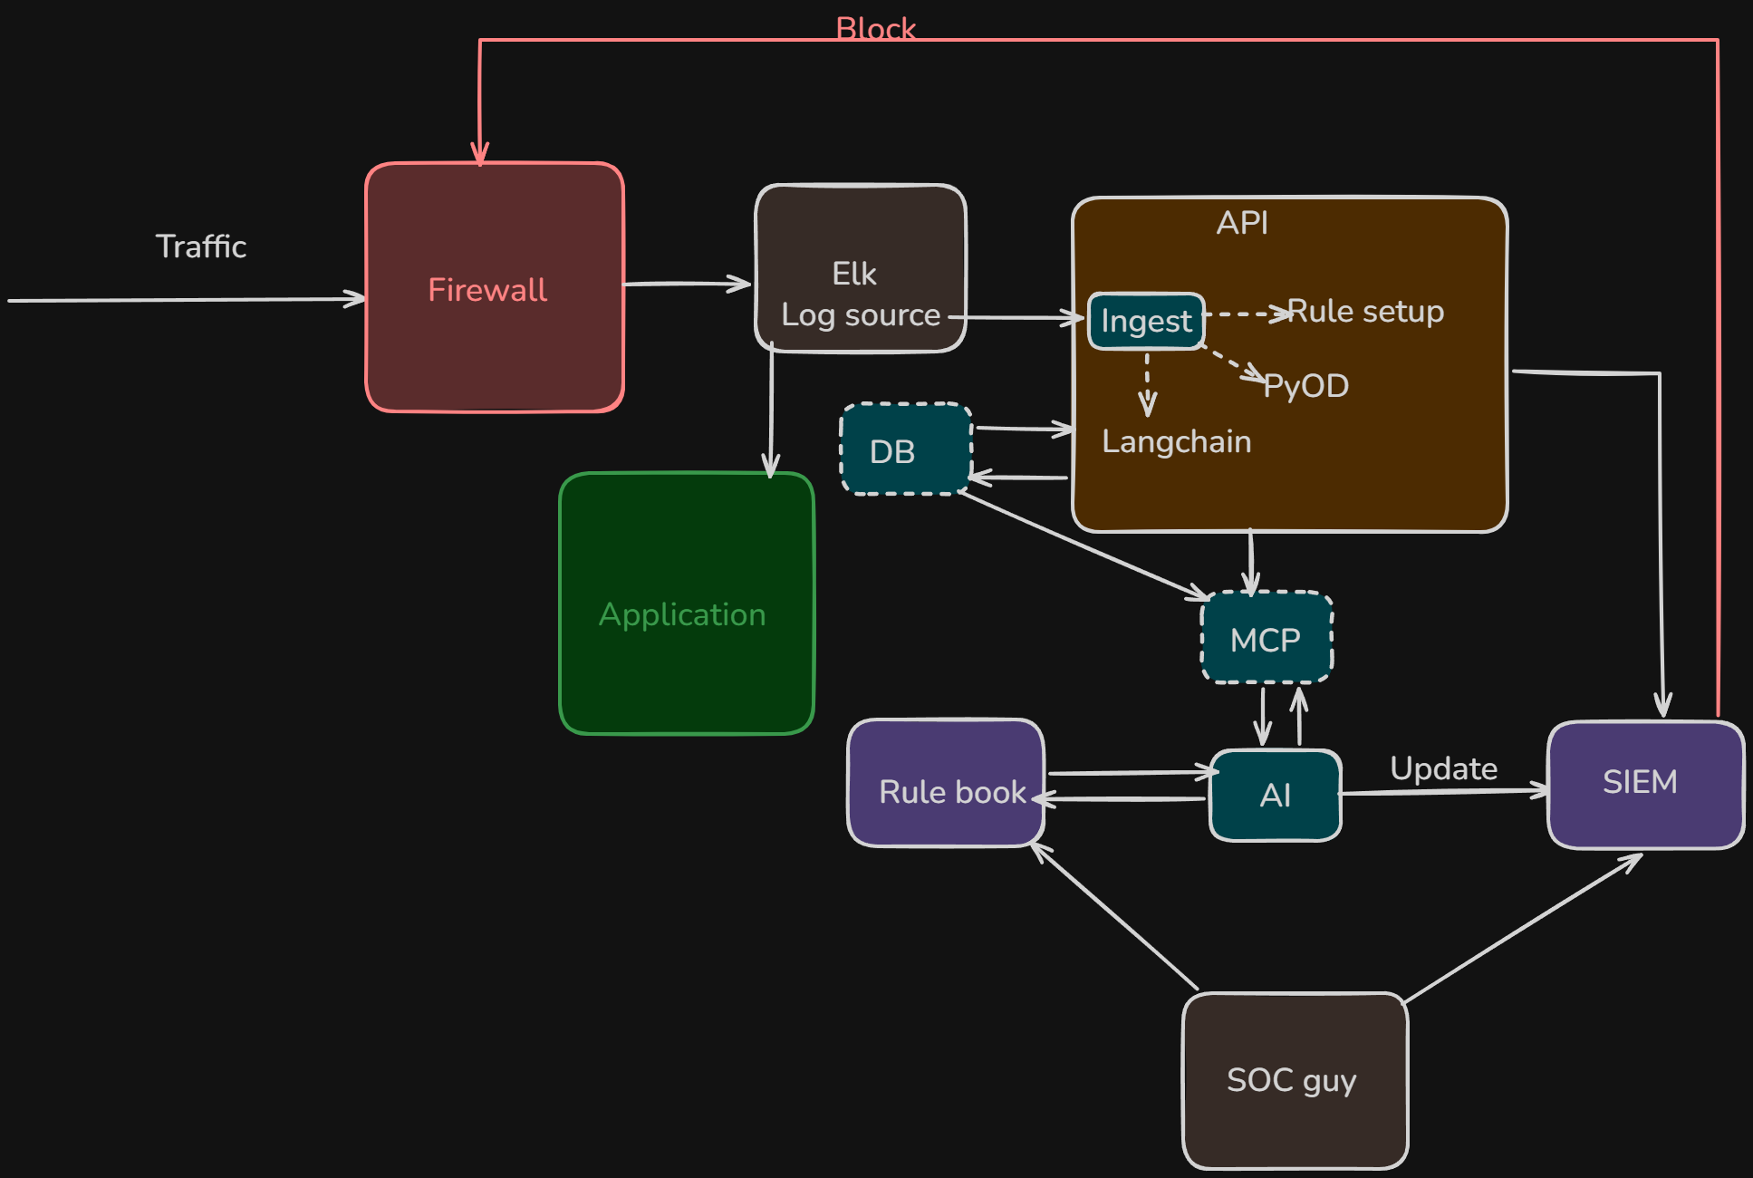
Architecture
2026
FEB
GiveInternshipPlease
CogniSieve Core operates as an AI validation layer between ELK and SIEM, ingesting logs, ranking alert fidelity, and escalating only high-confidence incidents.

Slide 10
Software Design
2026
FEB
GiveInternshipPlease
Behaviour Layer
Time series feature extraction and behavioural baselining
Ingestion Layer
Intelligence Layer
ELK Log source combined with a secure python interface
Anomaly Models, Correlation Engines and Fidelity scoring model

Slide 11
Software Design
2026
FEB
GiveInternshipPlease
Reasoning Layer
Escalation Layer
Local LLM (Ollama) via LangChain or LangGraph
Validated alerts resulting in SIEM updates

Slide 12
Design Principles
2026
FEB
GiveInternshipPlease
Zero External Network Dependency
Modular and reusable components
SIEM-agnostic Integration
Controlled AI access via APIs
Encoded rulebook grounding

Slide 13
How It Works
2026
FEB
GiveInternshipPlease
From raw logs to validated, high-confidence incidents in three intelligent steps.

Slide 14
How It Works
2026
FEB
GiveInternshipPlease
Log Ingestion
Normalization
Extract
Collects logs from ELK and security sources in real time.
Standardizes structured and unstructured data for analysis.
Derives behavioral and statistical indicators from log data.
Detect
Correlate
Escalate
Applies UEBA and anomaly models to identify deviations.
Correlates cross-system events and assigns a fidelity score.
Generates response steps and updates the SIEM with validated alerts.

Slide 15
Feasibility of Solution
2026
FEB
GiveInternshipPlease
Practical & Deployable
Operational Viability
Built entirely in Python
Uses production-ready open-source tools
No proprietary dependencies
Runs within on-prem or air-gapped environments
Integrates with existing SIEM infrastructure
Modular Components allow phased deployment
Works alongside existing rule-engines
Can mature into automated containment workflows.

Slide 16
What makes us different?
2026
FEB
GiveInternshipPlease
Them
Us
Purely Rule-based alerts
High false positive rates
Manual Cross system correlation
Reactive investigation workflows
Cloud-dependent AI solutions
AI fidelity ranking before escalation
Behavioral correlation across systems (UEBA)
Automated playbook generation
Fully offline, zero data exposure
SIEM-agnostic validation layer

Slide 17
Tech Stack and Infrastructure
2026
FEB
GiveInternshipPlease
Core Stack:
ELK (log foundation)
Python (control layer)
PyOD (anomaly detection)
Tsfresh (time-series features)
LangChain (reasoning orchestration)
Ollama (offline LLM hosting)
FastAPI (secure interface layer)

Slide 18
Tech Stack and Infrastructure
2026
FEB
GiveInternshipPlease
Security Controls:
No external API calls
No cloud LLM storage
No outbound data transmission
Controlled system interaction through API boundary

Slide 19
04
Business Impact
2026
FEB
GiveInternshipPlease
Reducing alert fatigue while accelerating detection and response.

Slide 20
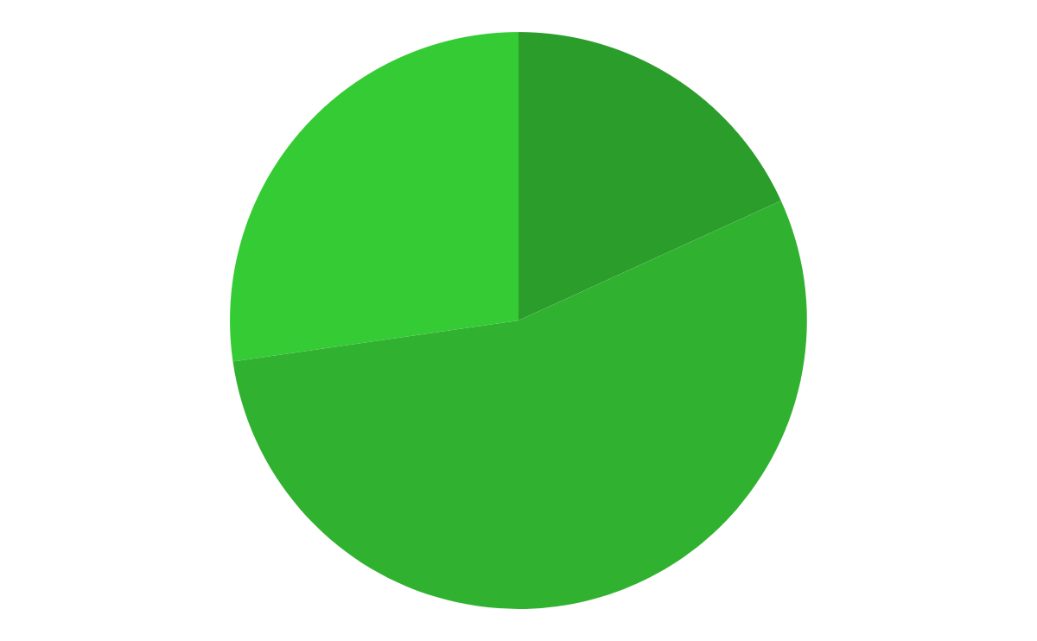
Deployment Focus
2026
FEB
GiveInternshipPlease
60%
Banking SOC
Handles high-volume enterprise alerts
20%
GRC Teams
30%
Governance, risk and compliance oversight
Enterprise SOC
Cross-Industry security operations teams
Follow the link in the graph to modify its data and then paste the new one here. For more info, click here

Slide 21
Business Impact
2026
FEB
GiveInternshipPlease
Reduce Noise
Improve Visibility
Increase Speed
Cuts false positives before SIEM escalation.
Unifies cross-system intelligence into one view.
Accelerates detection and response.
Lower Fatigue
Boost Accuracy
Strong Security
Reduces analyst overload.
Ranks alerts by confidence.
Enables consistent, intelligence-driven response.

Slide 22
Our Team
2026
FEB
GiveInternshipPlease
Samaira
Frontend Developer
Abihimanyu
AI and Infrastructure Developer
Janmeyjay
Garima
Team Lead
Mercury is the smallest planet in the System
Shreyas
Backend Developer

Slide 23
Thanks!
2026
FEB
GiveInternshipPlease
Do you have any questions?
js8425@srmist.edu.in
https://github.com/J300-0/GiveInternshipPlease
Team: GiveInternshipPlease
Please keep this slide for attribution

